Slide 1
Object Oriented Programming
Lecture 1

Slide 2
Introduction
Let’s know about the Instructor
Asma Sanam Larik
asma.larik@sse.habib.edu.pk
E 110 Monday- Wednesday (11:00—12:00)
Let’s hear from the students

Slide 3
Motivation
Let’s see what the Instructor thinks about students
One wheeling Video what do you think ?
an openness to the new.
the hunt for the unusual or unexpected.
Risk taking
A desire to be the best among peers

Slide 4
Motivation
Let’s see what the Instructor thinks about students
Eagle video what do you think ?
Strength
Fearlessness
Opportunistic
High aims
Kind and caring
Risk taking
Excellence

Slide 5
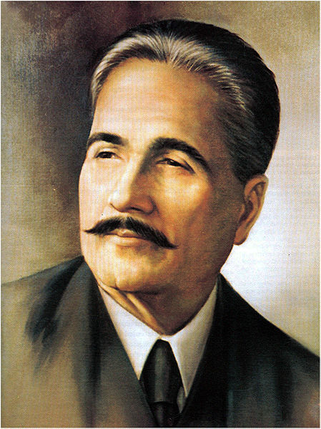



The poet of east and youth
He talks to the risk takers, the thrill lovers and the sensation hunters and calls them shaheen meaning the eagle

Slide 6

THE BIG IDEA

Slide 7
Motivation
Let’s see what the Instructor thinks about programming
Programming video what do you think ?
https://www.youtube.com/watch?v=I-EwobCl0ik
https://propakistani.pk/2017/08/21/1069-robots-just-broke-guinness-world-record/?utm_source=all_users&utm_medium=notif
Twenty first century literacy is programming
“Power will soon belong to those who can master a variety of expressive human machine interaction *”
http://edutopia.org/programmming-the-new-literacy
Notes:
or

Slide 8
Programming Tips?
Writing a program is the process of creating something from nothing
The process of something that solves a real world problem and hopefully makes world a better place
If you learn to program in one language then you can easily switch to other language
Read actively and think about what you are reading

Slide 9
Getting HELP !!!!
If learning to program is difficult then learning to
learn to program is equally tricky!
The most important thing is that you need to know when you should get help from one of your experts
get help too soon and you’ll end up not learning
but leave it too late and you run the risk of not finishing your program in time.

Slide 10
Getting HELP !!!
At some point in the not too distant future you’ll be sitting in front of a computer trying to write a program and you’ll find that you’re “stuck”.
It happens to all of us.
You might have some sort of error message that you just can’t work out
There is no shame at all in getting stuck; it happens to all of us and it happens to all of us all the time.

Slide 11
Getting HELP !!
Try re‐reading the relevant chapters of this book.
Look at some programs that do something similar to what you want to achieve and try to adapt them.
Talk to one of your experts. (Teacher, RA’s, TA’s)

Slide 12
Course Introduction
Let’s see what the instructor has planned for the course and what is it all about ??
Course Objectives
Course Outline
Learning Outcomes
Books
Programming Language and Tools

Slide 13
Course Objectives
Basic introduction of Objects and how they can help in defining new programming methodologies.
We will start from defining a simple linked list and slowly make it more complex.
Data encapsulation: classes, namespaces, constructors and destructors; virtual functions and destructors; operator overloading and standard input/output.
Inheritance and polymorphism; templates; standard library containers.
We will use these topics in creating a working game to give a visual feel of all the programming techniques that we will study in class.
Designing will be a major part of the entire activity; hence we will learn UML 2.0 and learn to design our software.

Slide 14
Weekly Course Outline
Week 1 | Introduction to C++, variables, conditionals and loops
Week 2 | Functions, Pointers and debugging
Week 3 | Arrays, Structures, Classes and Array of Objects
Week 4 | Introduction to UML 2.0 (Class Diagrams), Objects, data encapsulation pointers to objects
Week 5 | Dynamic object creation and deletion, Simple Stack and Queue Implementation (Exam Week)
Week 6 | Inheritance, constructors and destructors
Week 7 | Virtual functions, abstract classes and virtual destructors
Week 8 | Polymorphism, functions overloading and overriding
Week 9 | Double Linked List for storing child objects using a base pointer
Week 10 | Copy Constructor, shallow and deep copying, Friend Classes
Week 11 | Project Implementation using OOP techniques (Exam Week)
Week 12 & 13 | Design Patterns
Week 14 & 15 | Exception Handling, File Input Output
Week 16 | Project Evaluation and Final Assessment

Slide 15
Learning Outcomes
Understand the concept of Object Oriented Programming and apply that into creating their own games and other desktop based applications.
Students will go through rigorous programing assignments and a final semester project to understand how the different modules come together in creating a complete project.
UML 2.0 will be used in designing the individual projects so that the students put into practice the designs that they have created in a working game.

Slide 16
Books
Bruce Eckel’s “Thinking in C++” 2nd Edition.
Bjarne Stroustrup “The C++ Programming Language” 4rth Edition 2013
Jacobson et al. “Unified Modeling Language” 2nd Edition Addison Weasely 2005

Slide 17
Programming Language/ Tools
Motivation for using C/C++; as opposed to other languages like Java, C# and Python.
Why C++ ??
XCode and SDL 2.0 will be used (You can also use Code::Blocks with MinGW, Dev C++ or Visual Studio at your home PCs if you like).

Slide 18
Format and Procedure
Students will be given an assignment every other week that they need to submit by 11:59 pm on the day before next assignment.
A total of 6 assignments will be given where the weightage of each assignment will be 3%.
There are going to be no quizzes or exams but that means that strong emphasis will be given to written code, logic and design.

Slide 19
Final Project
Students will create group projects and they will need to show periodic advancement to verify their progress and to ask questions if they are stuck.
These periodic meetings are mandatory to exhibit that the final project was created by the students.
The project will be distributed in parts and every part will hold separate marks. A rubric will be provided for the evaluation of each part.

Slide 20
Attendance Policy
Habib University requires that all first and second year students must maintain at least 85% attendance for each class in which they are registered.
Non-compliance with minimum attendance requirements will result in automatic failure of the course and may require the student to repeat the course when next offered.

Slide 21
Grading policy
Assignments (18%) 6 Assignments total Mid Terms (30%) 2 Mid Terms (In Week 5 and Week 11) | Final Project (52%) To be distributed in modules Individual modules will be assessed. Completeness will dictate the final score (Scoring will be based on Viva)
60% score needs to be scored to be eligible to work on the Project. You will not be allowed to continue if your progress is not satisfactory. | 60% score needs to be scored to clear the Project. Insufficient score fails the course Irrespective of whether the assignments were cleared
A+ | 95 - 100 | Object Oriented Programming & Design Methodologies course is composed of intense programming exercises and assignments. This means that you will not be put under undue stress of quizzes, but you will need to create your skills and understanding through rigorous practical application of concepts. The assignments will be given as a group activity only to help with the checking. Every person of the group is required to do the assignments on their own. They can however take help from their colleagues, friends and peer tutors provided they write their own code. It is strongly recommended that you start working on the assignment the very day you get it. Assignments WILL take time, so the sooner you start the better.
A | 90 - 94
A- | 85 - 89
B+ | 80 - 84
B | 75 - 79
B- | 70 - 74
C+ | 65 - 69
C | 60 - 64
F | 0 - 59

Slide 22
Object Oriented Programming
What is Procedural Programming ?
What is Object Oriented programming?
Example of Object Oriented Model

Slide 23
Procedural Programming
A procedure is a set of programming language statements that, together, perform a specific task.
Procedures typically operate on data items that are separate from the procedures.
In a procedural program, the data items are commonly passed from one procedure to another.

Slide 24
Procedural Programming
Data Element
Procedure A
Procedure B

Slide 25
Procedural Programming
In procedural programming, procedures are developed to operate on the program’s data.
Data in the program tends to be global to the entire program.
Data formats might change and thus, the procedures that operate on that data must change.

Slide 26
Object-Oriented Programming
Object-oriented programming is centered on creating objects rather than procedures.
Objects are a melding of data and procedures that manipulate that data.
Data in an object are known as attributes.
Procedures in an object are known as methods.

Slide 27
Object-Oriented Programming
Object
Attributes (data)
Methods (behaviors / procedures)

Slide 28
Example of Object Oriented Model
Person
Car
Table
Class Room

Slide 29
Conclusion
We have to work hard in this course
Practice makes perfect
Programming is the literacy of twenty first century
Object Oriented is the programming model of real world and we have to master it (OK)

Slide 30
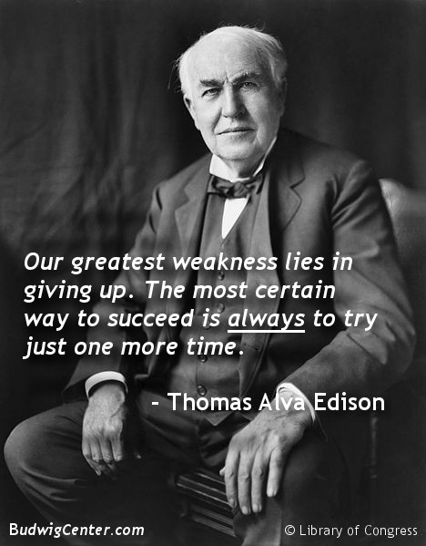
Questions ????
Don’t give up!

